Slide 1


Group 20:
Yaozu Li (s2298215)
Yu Liang (s2302674)
Xueying Zhang (s2342071)
Ruoshi Zhang (s2304877)

Slide 2
Outline
Assumptions
Model
Visualizations
Recommendations
Q&A

Slide 3
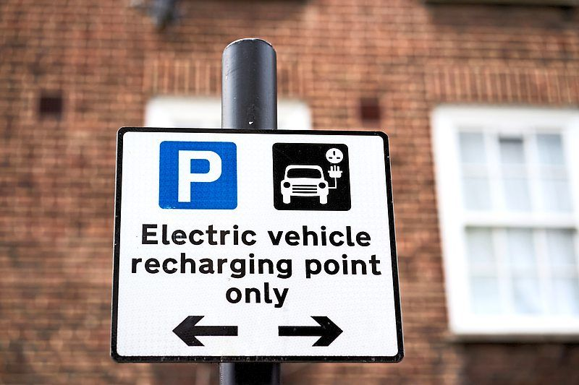
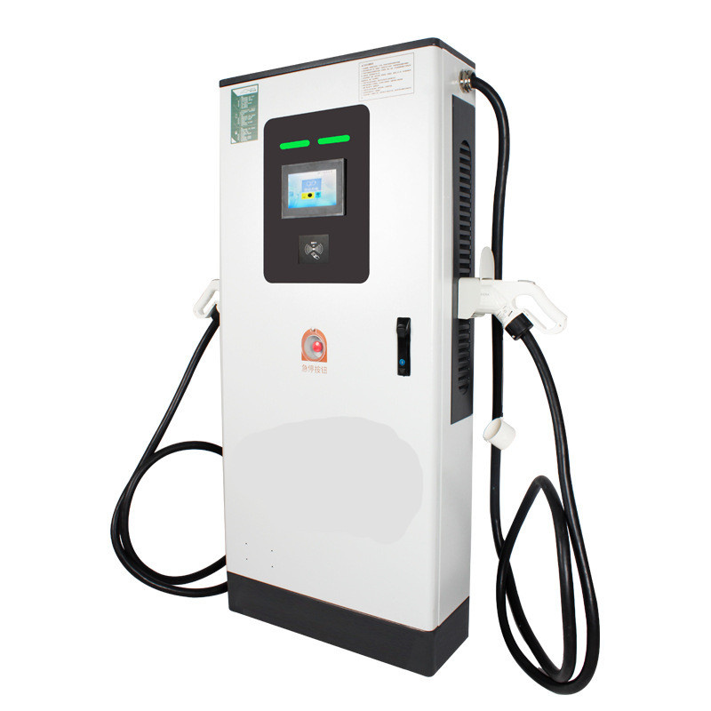
Point
Assumptions
£5100
……

Slide 4
Station
Assumptions
Slow: 3000 kwh/y
£1600
Fast: 5000 kwh/y
£2000
Rapid: 50000 kwh/y
£2400

Slide 5
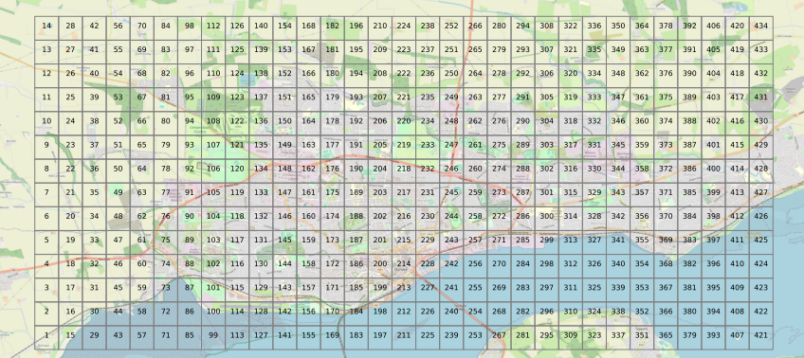
Model
Original

Slide 6
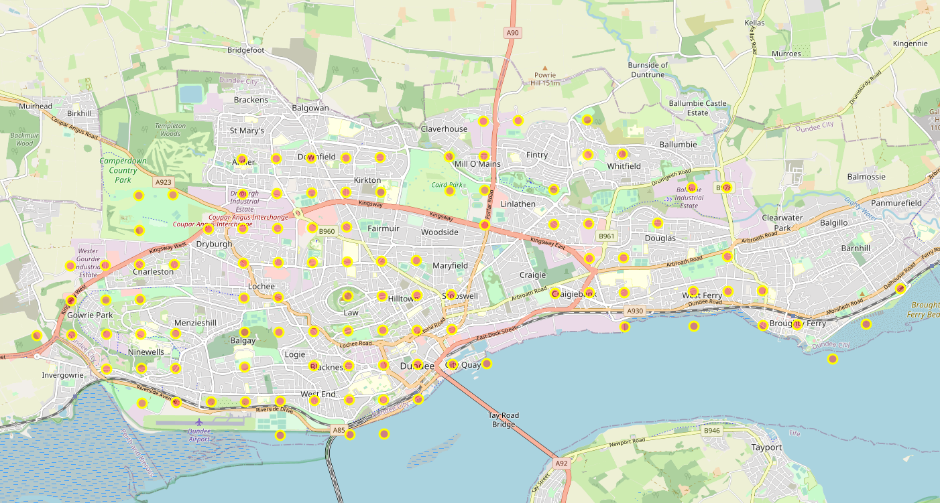
Model
Demand

Slide 7
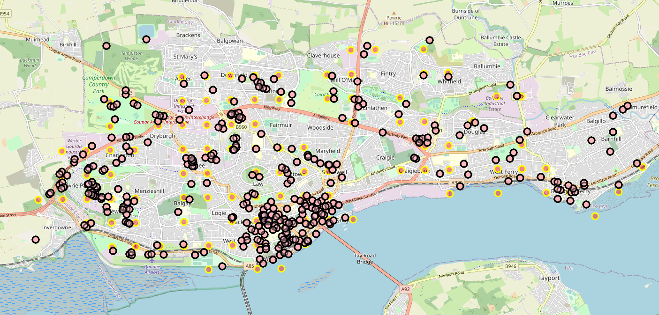
Model
Demand + Point

Slide 8
Model
Non-decrease points/stations
Density (20+5*no_stations)
Demand satisfaction (80%)
Max 10 stations
No single rapid point

Slide 9
Model
Min cost
Min interest distance

Slide 10
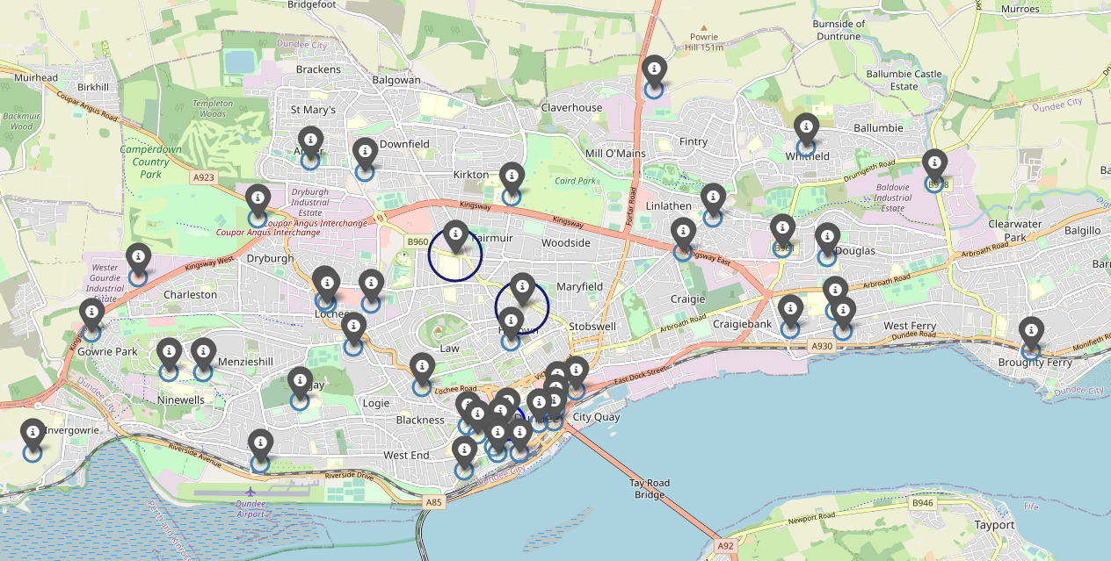
Visualizations
Current

Slide 11
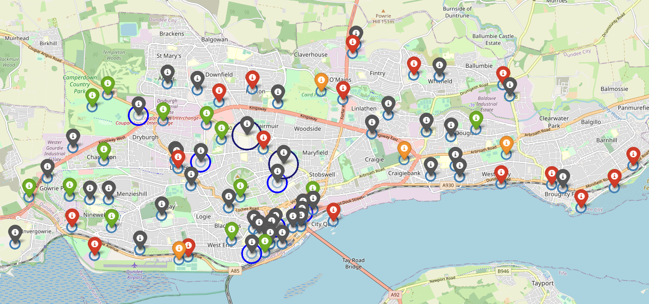
Visualizations
Min cost

Slide 12
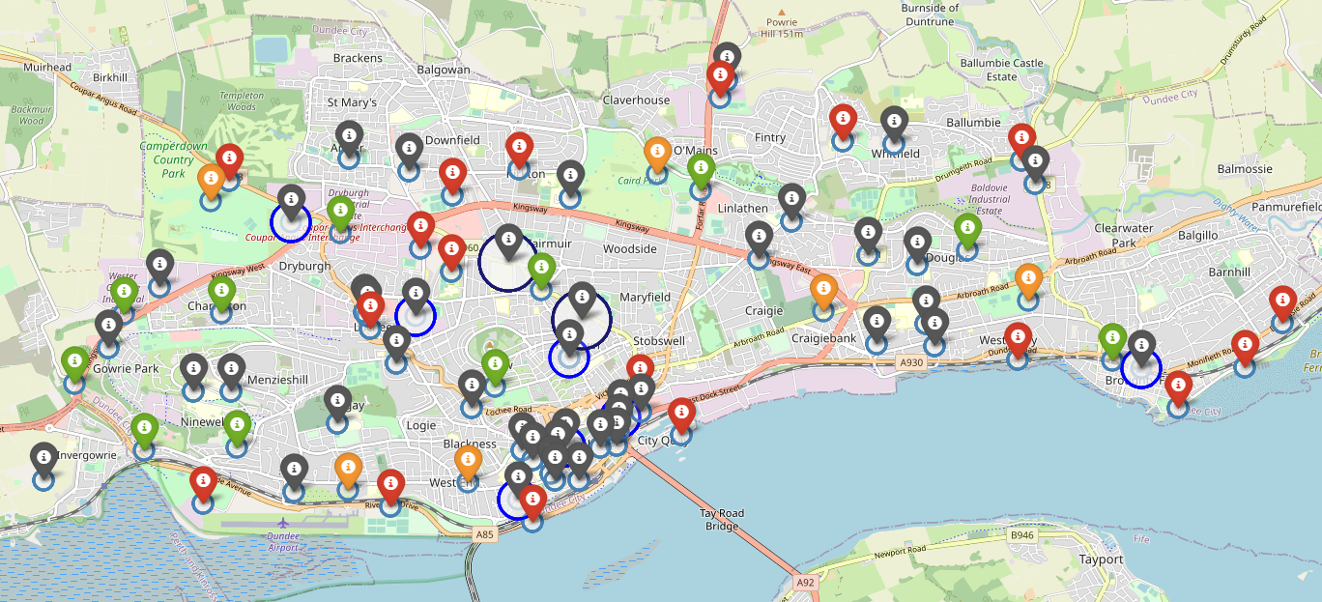
Visualizations
Min Interest Distance

Slide 13
Recommendations
Min
Cost
Interest Distance
£
325700
328900
Distance Unit
5784.183
5293.412
Base on Assumptions

Slide 14
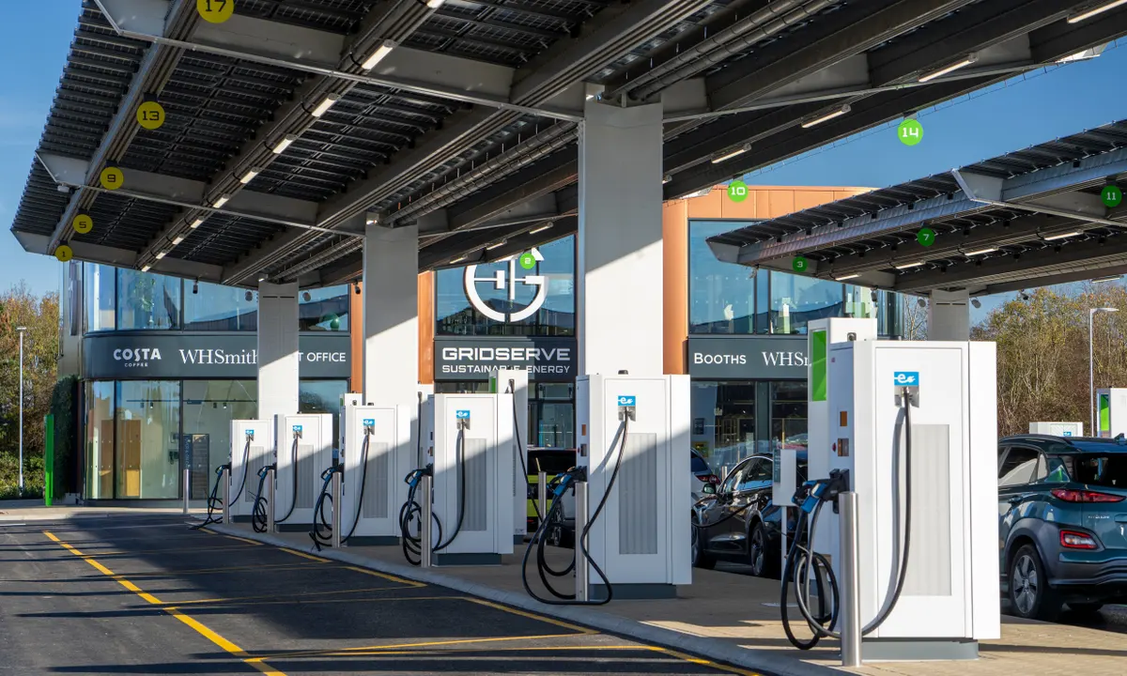
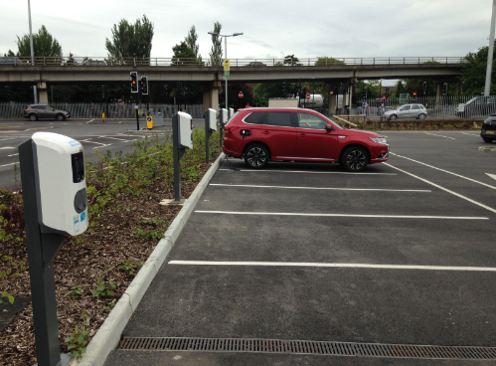
Recommendations
Fuel
Parking
Charging ≠ Fueling

Slide 15
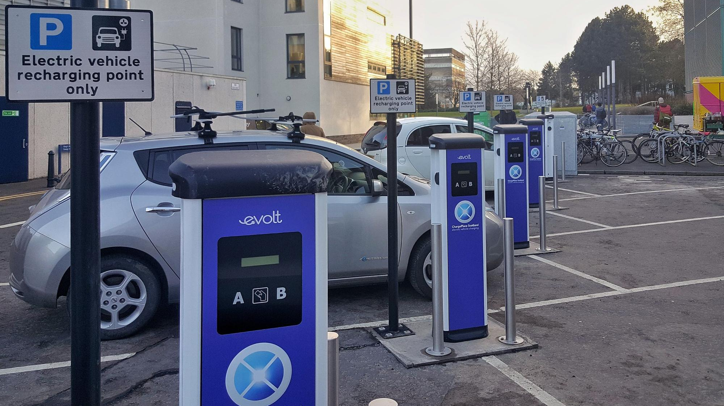
School

Slide 16
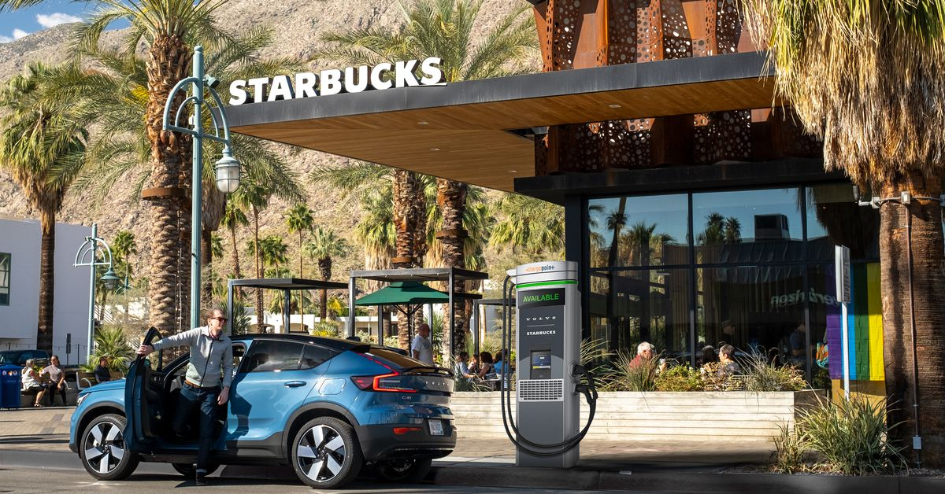
Café

Slide 17
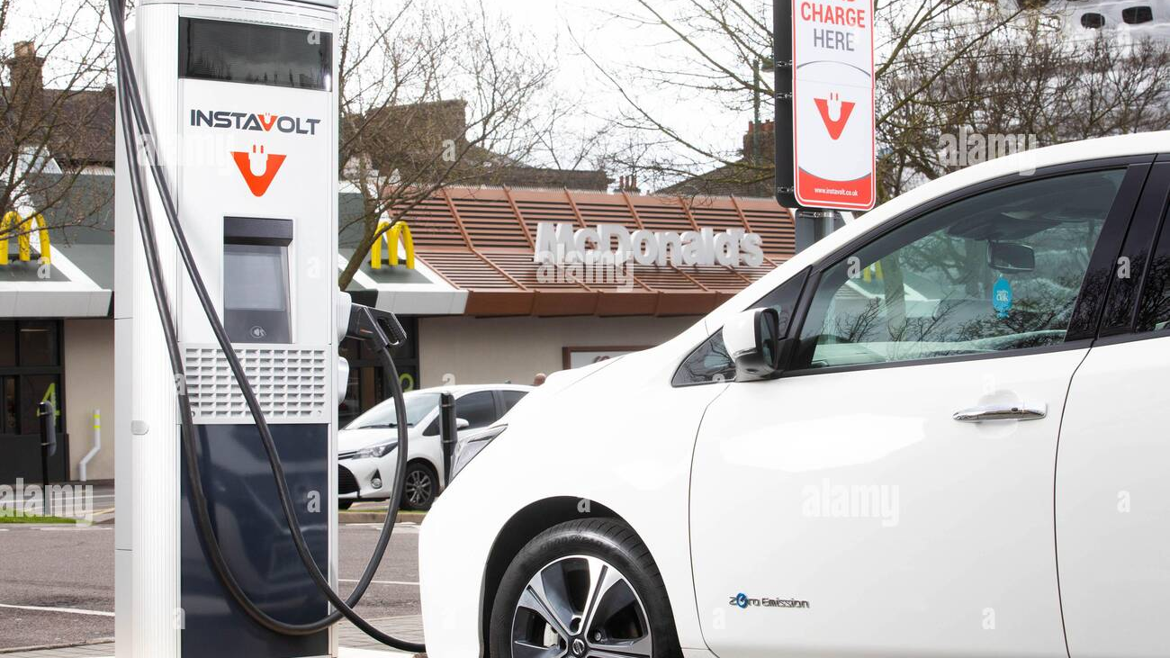
Restaurant

Slide 18
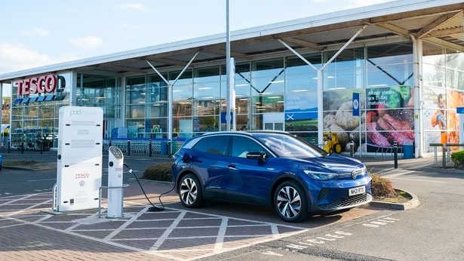
Supermarket

Slide 19
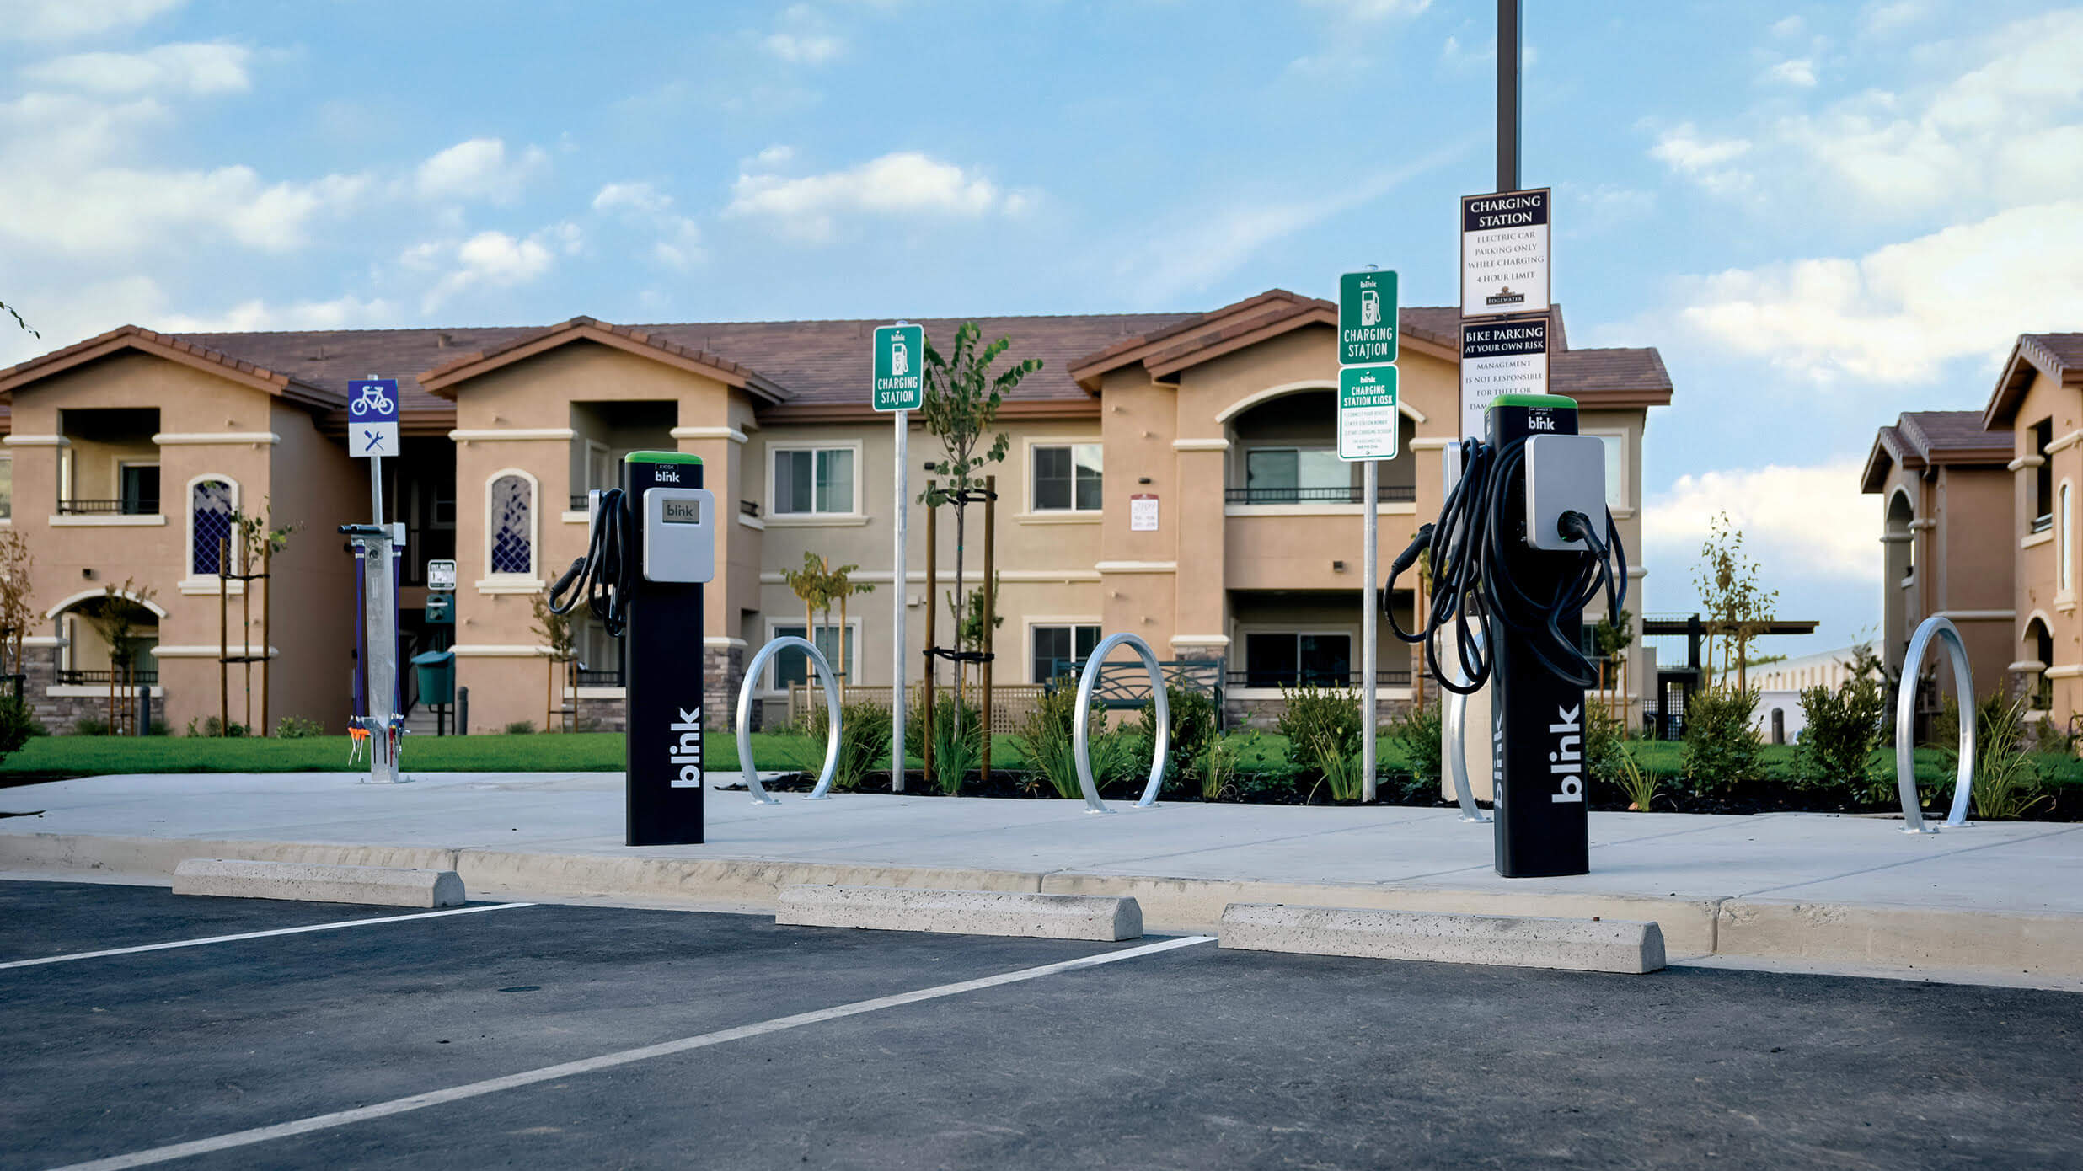
Neighborhood

Slide 20
Q&A

Slide 21
Reference
Pictures
https://www.coescaledonia.com/quality-assurance/dundee-city-council-logo/
https://www.ed.ac.uk/maths/bsde-spde-2017/sponsors
https://www.thestar.com.my/lifestyle/living/2021/06/28/after-phone-boxes-charging-points-may-become-the-new-icon-of-britishness
https://www.alibaba.com/product-detail/60KW-80KW-DC-fast-ev-charger_1600428919928.html
https://creativevip.net/resource/15-electric-car-icons/
https://www.theguardian.com/environment/2020/dec/07/uk-first-all-electric-car-charging-forecourt-opens-in-essex
https://www.chargeyourcar.org.uk/news/8-new-charge-points-for-new-malden/
https://www.theverge.com/2022/3/15/22977536/volvo-chargepoint-ev-chargers-starbucks-dc-fast
https://www.plugshare.com/location/141609
https://www.alamy.com/editorial-use-only-general-view-of-an-instavolt-charger-in-a-mcdonalds-carpark-as-the-food-chain-announces
-plans-to-introduce-electric-vehicle-ev-rapid-charging-points-as-standard-across-new-uk-drive-thru-restaurants-london-image364425511.html
https://www.walesonline.co.uk/whats-on/shopping/tesco-tops-list-supermarkets-offering-21666943
https://greenlivingmag.com/bringing-home-electric-vehicle-charging-stations/

